Slide 1
Data Analysis of TMDb 5000 Movies
Final Project Presentation
Presented by : Shaimaa Ahmed

Slide 2
Project objective
To analyze and understand the factors that affect a movie's success (e.g., revenue, popularity, ratings)

Slide 3
Explore the Data

Slide 4
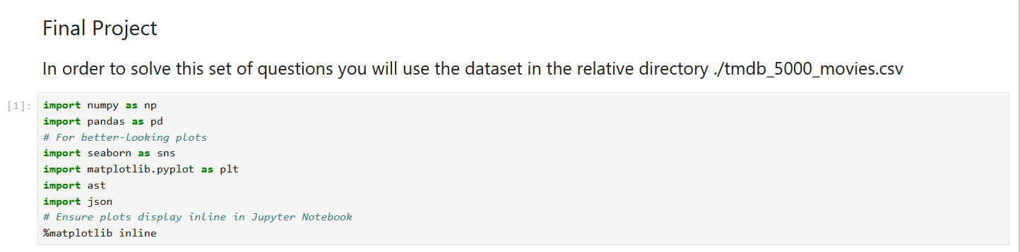
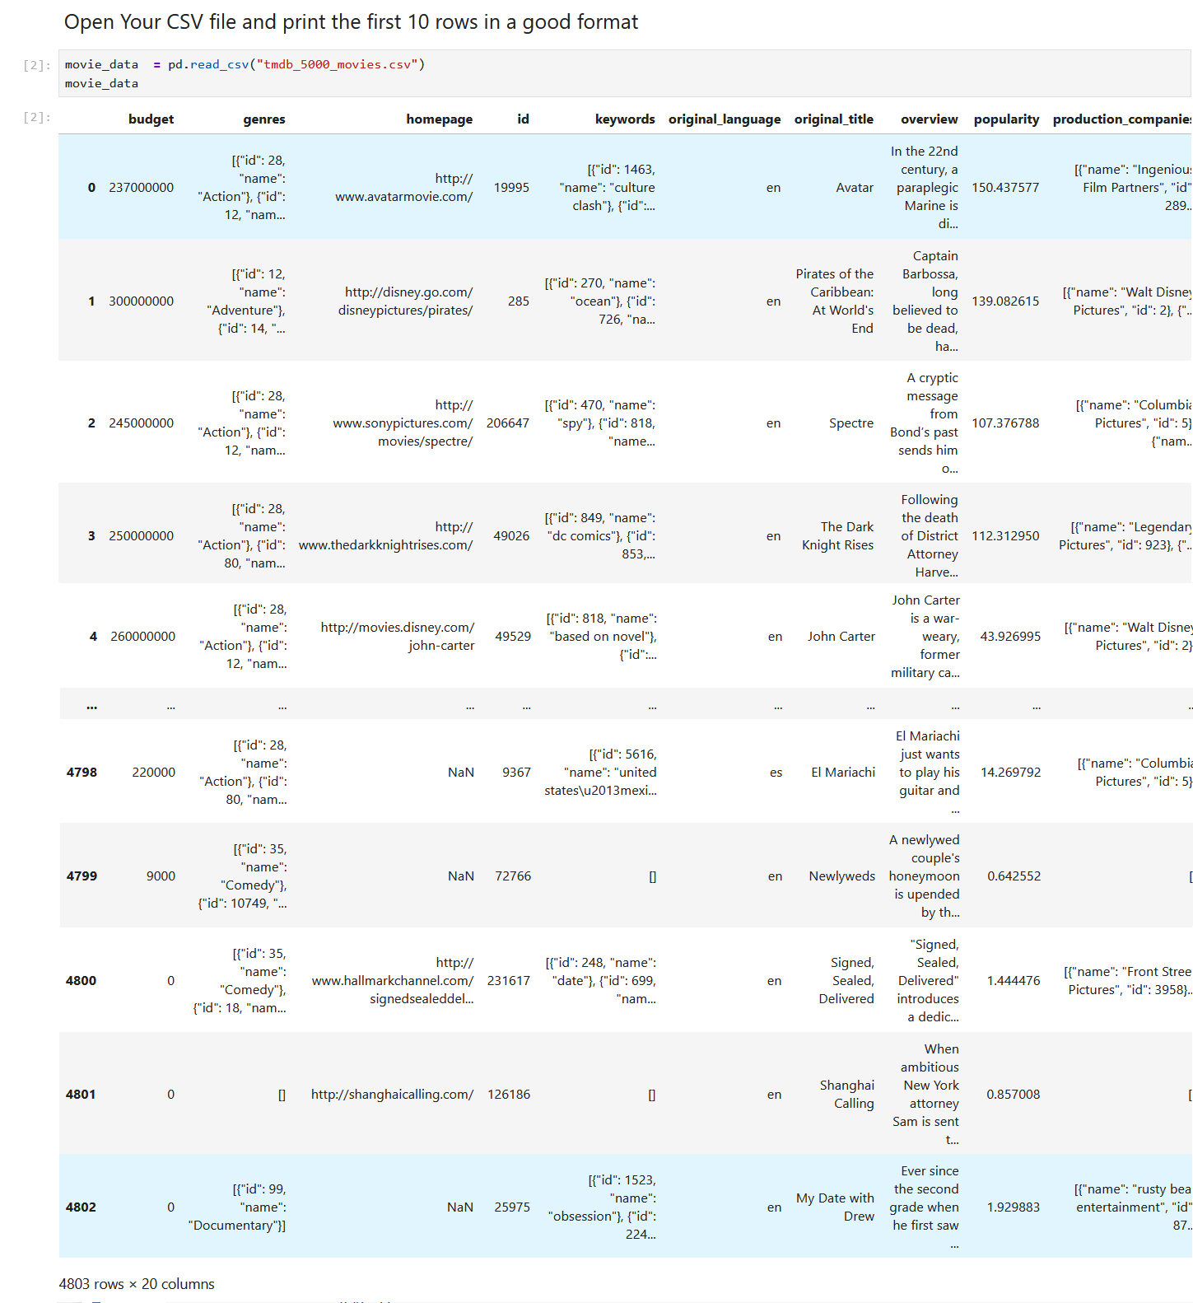
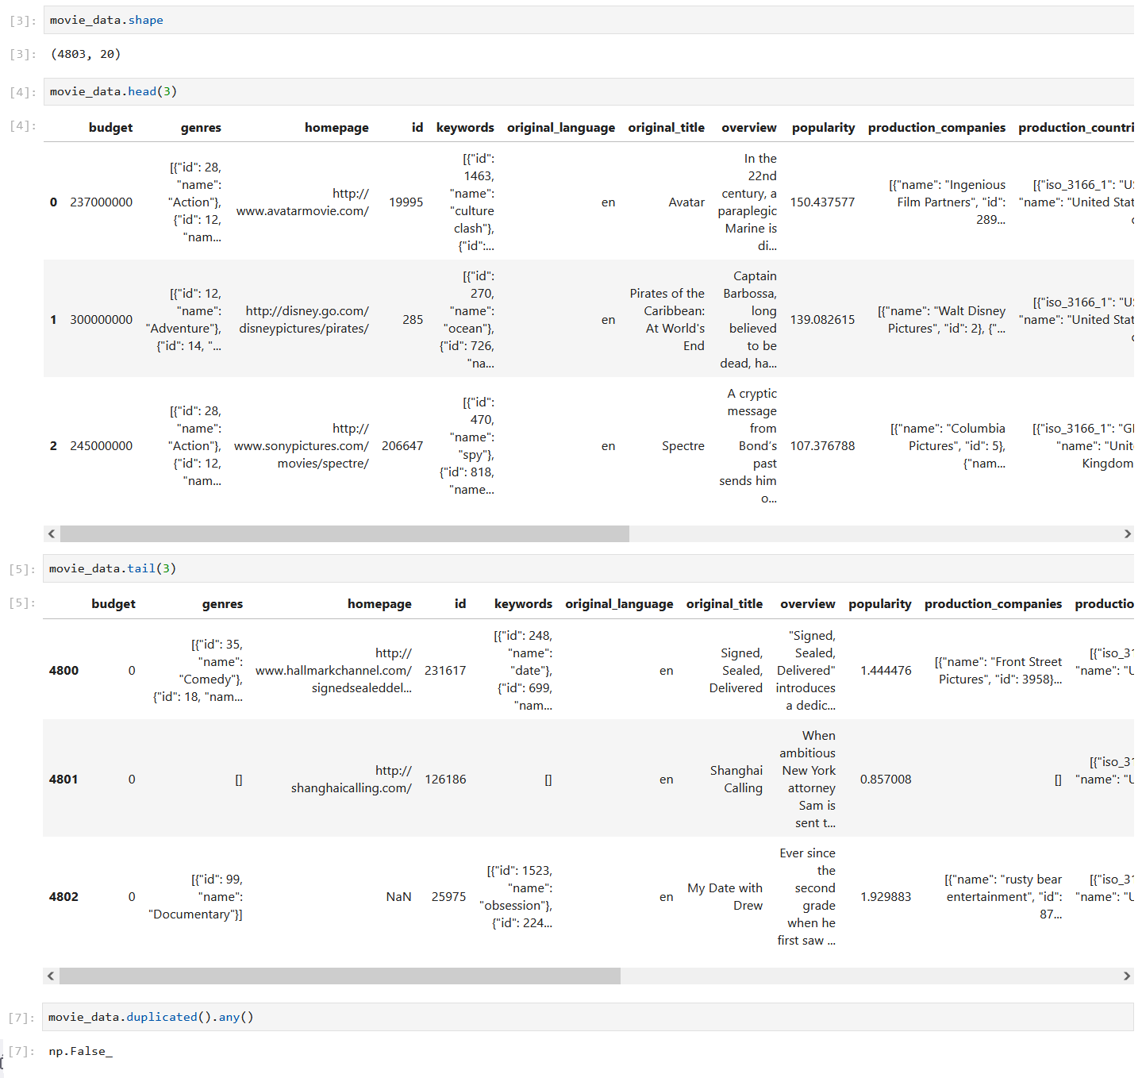

Slide 5
Check if there are any Nan

Slide 6
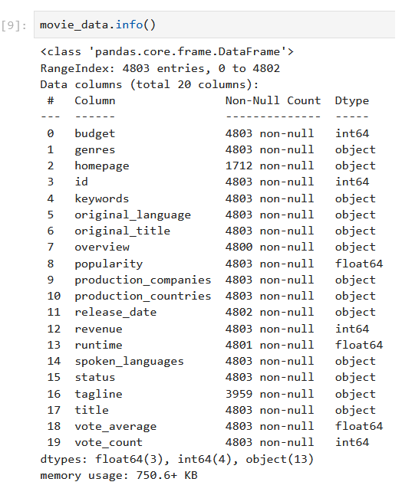
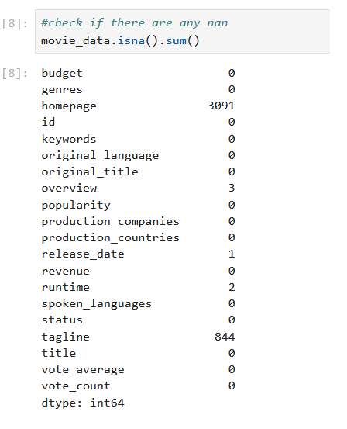

Slide 7
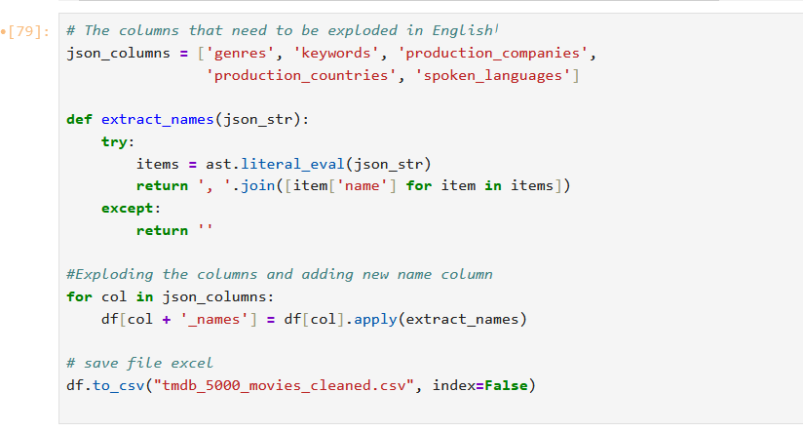
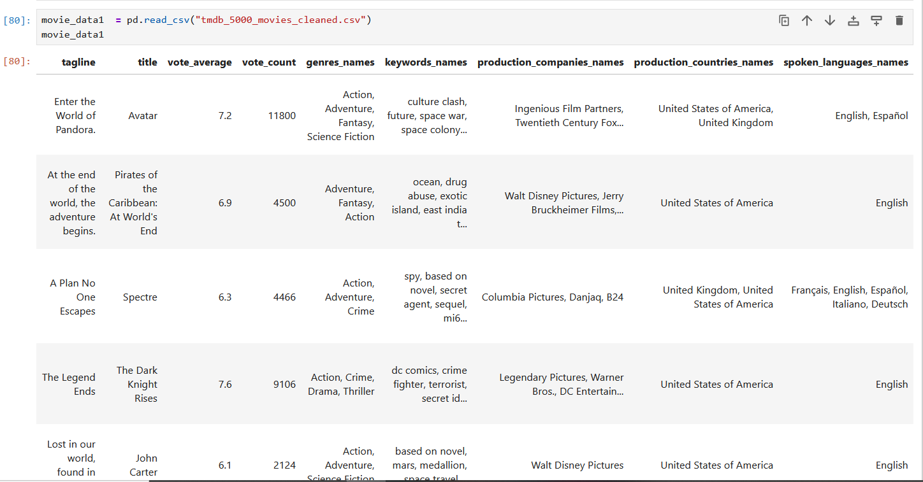

Slide 8


Slide 9
Answer Questions

Slide 10
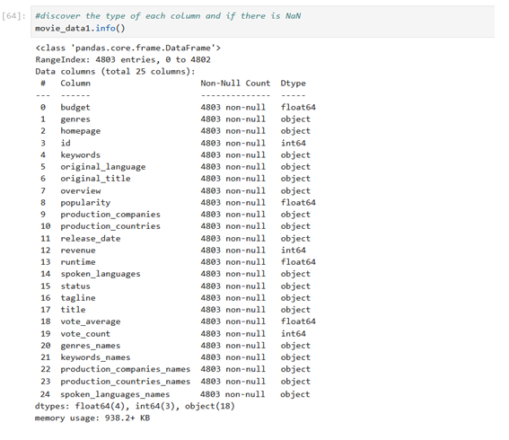
Q1:Discover the types of each columns and modify them if needed

Slide 11
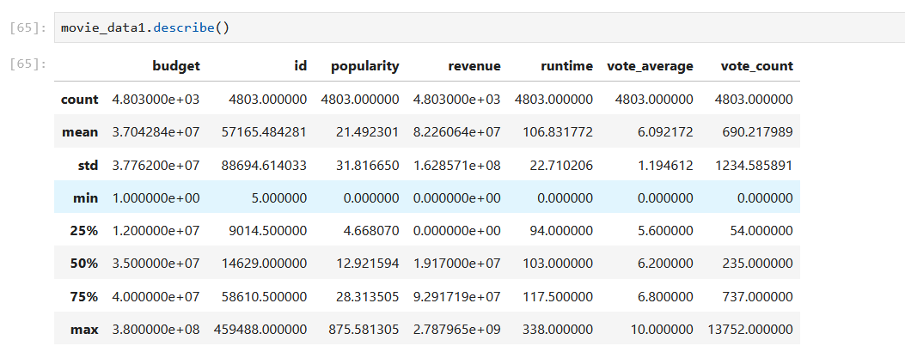
Q2: Give a very simple statistical analsys for the numerical columns

Slide 12
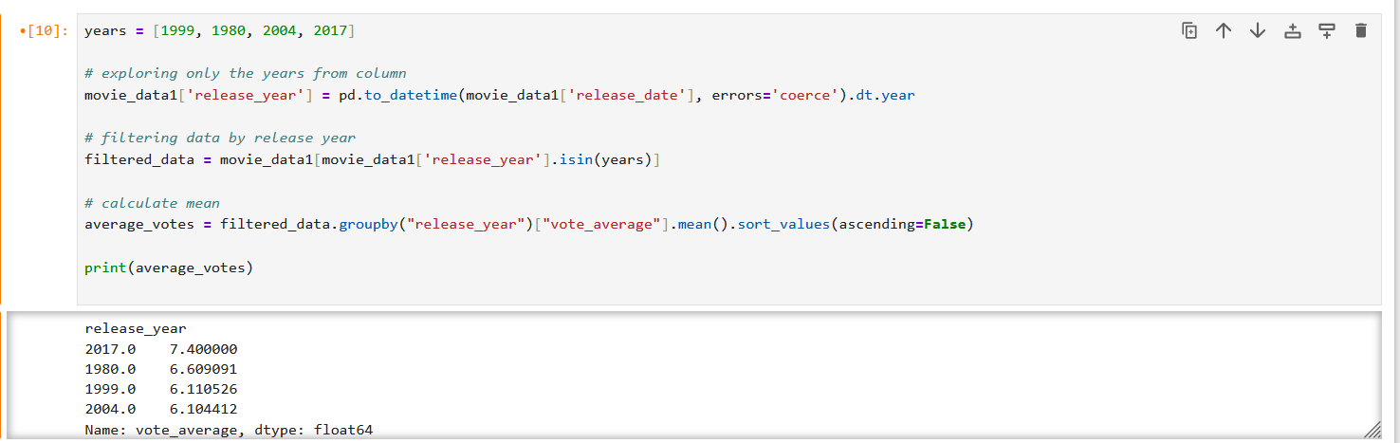
Q3: Calculate the mean rate for [1999, 1980, 2004, 2017] the movies grouped by years

Slide 13
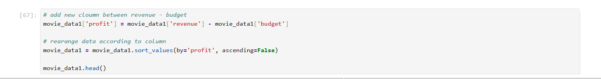
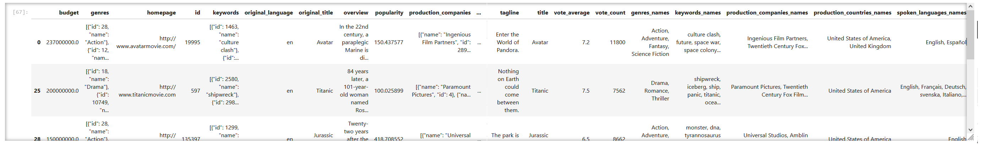
Q4: Rearrange the dataframe based on revenue - budget values

Slide 14
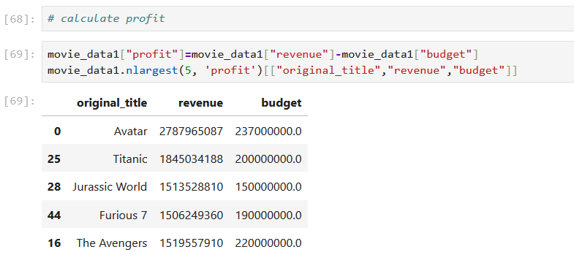
Q 5: Find the movies with top 5 revenue - budget value

Slide 15
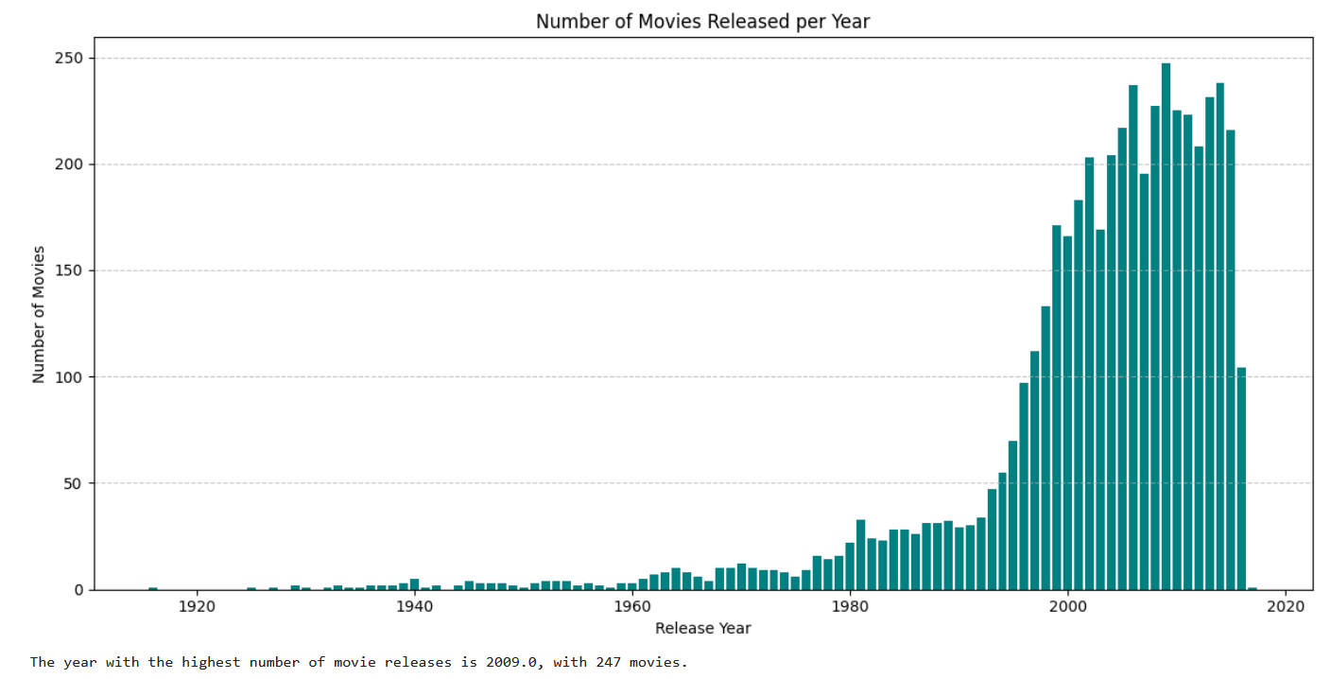
Q 6: Find the year with the highest number of movies release

Slide 16
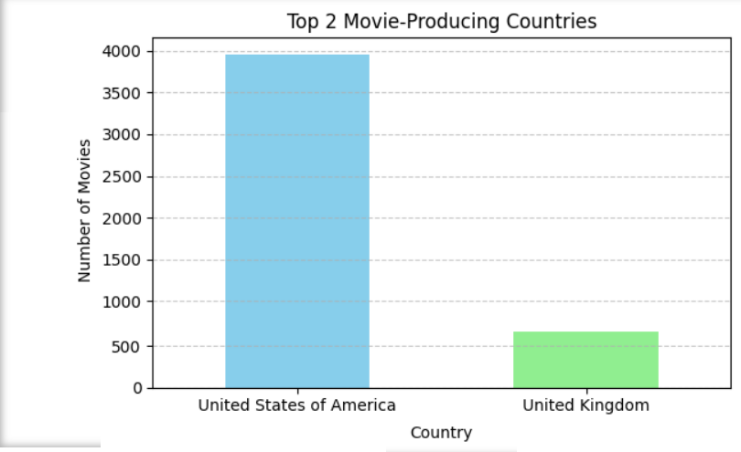
Q 7: Find the top 2 countries with the highest production movies number

Slide 17
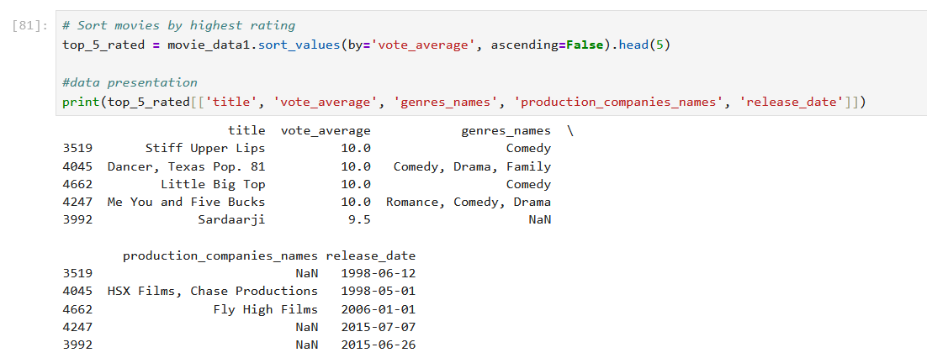
Q 8: Find the top 5 movies with the highest rate, and find if there anything common between them

Slide 18
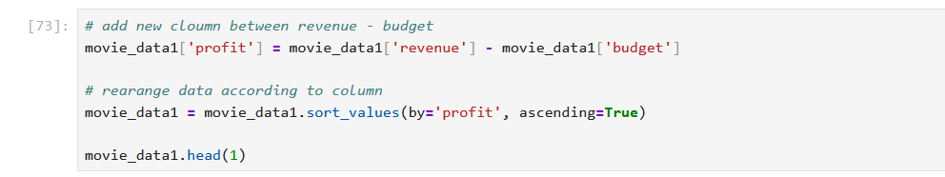
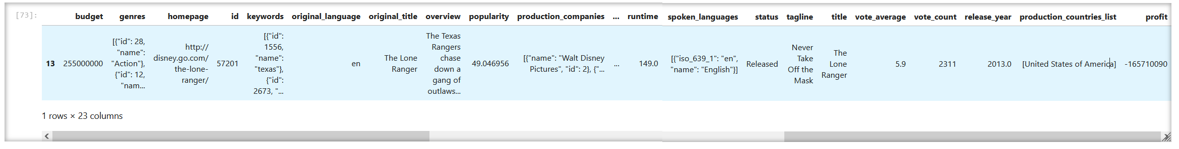
Q 9: Find the most unsuccessful movie along time in terms of revenue - budget

Slide 19
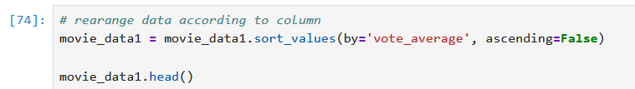
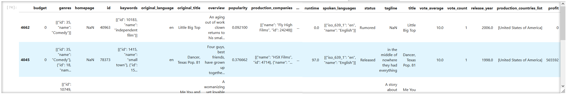
Q 10: Rearrange the dataframe based on vote_average column values

Slide 20
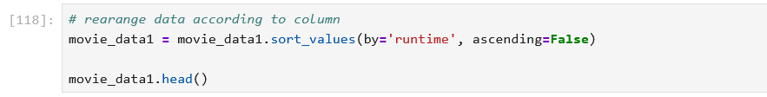
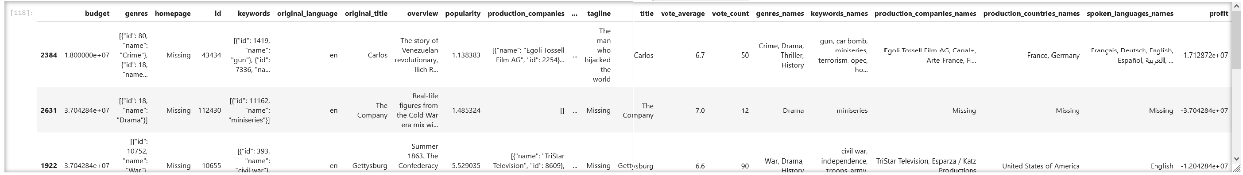
Q 11: Rearrange the dataframe based on runtime column values

Slide 21
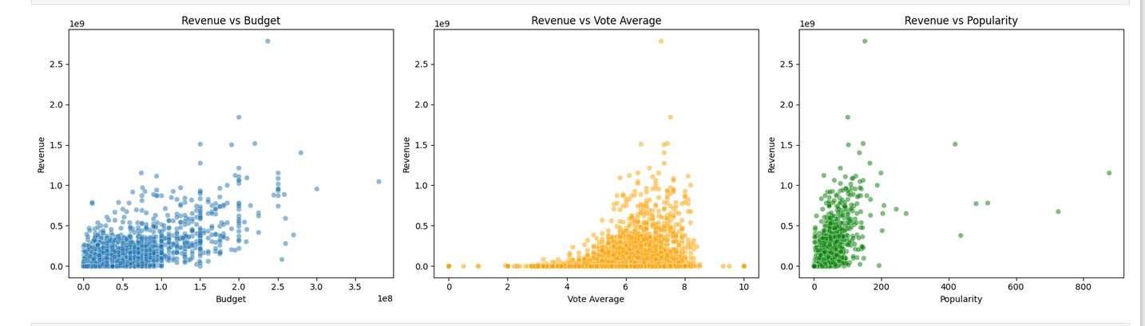
Q 12: In your opinion what is the highest variable that affects the revenue value (high coloration)
More money = bigger productions = more revenue (usually)

Slide 22
Thank you

